Slide 1
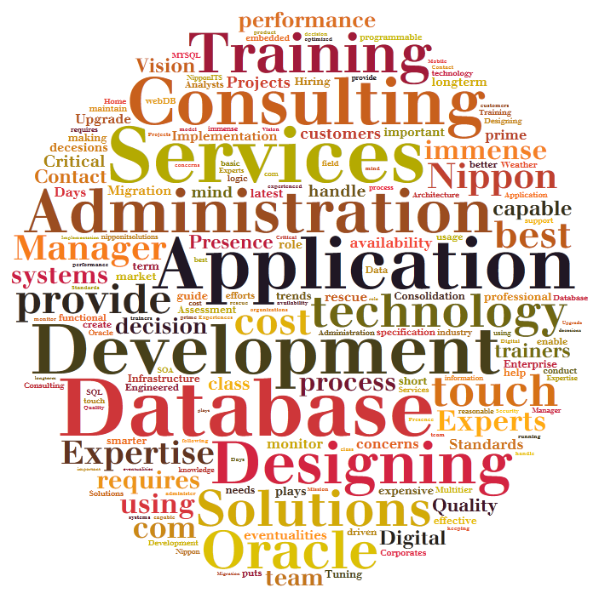



Database Services Offering
Year 2015
Version Draft

Slide 2
About Nippon ITS
Company Founded and Managed by Team with 10+ years Experience on Different Database and Oracle Applications Products.
We have one of best team of Experts (In house ,Freelancers and Contracts)
We follow SLAs and Security polices of customers and if not available we help building them.
Our team is highly Motivated ,Customer friendly and Passionate about their work.
We provide Services at reasonable prices and with very professional approach.
We are not “YES MAN” , we are honest , Straight forward and Even sometimes Blunt but all this is for benefits of our Customer. Our aim is to use experience to help you run your business effectively.

Slide 3





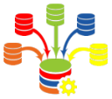


Administration Remote/onsite/Shared/Dedicated
Database Implementation
Database Migration and Upgrade
Database Assessment and performance tuning
Database Consolidation
Database Infrastructure and Oracle Engineered Systems
Database Designing
Database Services Key Offerings

Slide 4
Why DBA services from Nippon ITS?
Migration
And
Upgrade
24 X 7 X 365 Database Support
Performance Bottlenecks
Backup Recovery Support
Proactive Support
Storage Management
User Management
Round the clock DBA Availability
Single point of contact for each shift.
Experience and Expertise of team of DBAs at cost of 1
Providing daily / weekly reports of database issues
Solution for different Database Product under one roof.
Industry Experience / Certified DBAs
Strictly follows customer’s security guidelines
We maintain confidentiality of Customer data.
Suggesting how can we get more out of existing infrastructure.
Database

Slide 5
Methodology – Remote DBA Services
Database
Team of DBA will be getting tickets or requests and alerts from database systems.
DBA will login to database environment using VPN service of client or infrastructure provider.
DBA will access database system using virtual machine / Jump hosts in environment.
All Required Approvals will be requested by Contract management team and approved by customer SPOC.

Slide 6
Database Administration
Remote DBA – From Nippon ITS locations
Dedicated Services – Dedicated Team of DBA Assigned
Shared Services – A team of DBA maintaining Multiple Clients and Multiple Database.
Onsite DBA – At Client Side Dedicated DBA
On Demand – Vacation DBA – For existing customers - if they need project based ramp up or when their primary DBA is on Vacation.
Staffing Services – Provide DBA as Contract to Hire.
Database
Why Remote DBA?
Why Dedicated DBA?
Saving in Infrastructure cost ,Recruitment , Training cost and payroll costs
Multiple Shift resources taken care by us.
SME available for inability of frontline DBAs
Multiple platforms support.
Multiple Products Support
Complex Projects or Development Setups
High availability Requirements
Walking support required by Client teams
Unstable Environments
Heterogeneous Environments
Initial Implementation.
One Dedicated DBA at onsite as point of contact.

Slide 7

Implementation
Our Approach
Implementation Capabilities
Consulting
Basic Database Implementation.
Heterogeneous connected Database systems.
Golden Gate Setup for heterogeneous Environment for different Database products
Physical or logical Standby Database system for oracle database.
Real Application Clusters for Oracle Database.
Clustered MYSQL Database implementation.
Microsoft SQL Server Failover Database Implementation.
Database As Services Implementation using Oracle Engineered system and Oracle Enterprise Manager 12c
Prerequisite checks
DB product Installation
Database
Backup Strategies
Implement Backups
Monitoring Setup
Test Database
Test Backup and Restore
Documentation

Slide 8
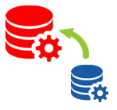

Migration and Upgrade
Our Approach
Capabilities
Consulting
Database version Upgrade
Oracle 9i to 12c
MySQL 5.x
Microsoft SQL Server 2000 to 2014
Oracle Applications Upgrade
Migrating environments to high-availability environments
Migrating database to EXADATA
Oracle Applications version Upgrades
Zero downtime upgrades and Migration.
Migration Tool Selection
Cook Book Creation
Database
Identify Data Issues
Impact Analysis present to Customer
Downtime and Impacts Approval
Implement Changes
Test The System
Update Documentation

Slide 9
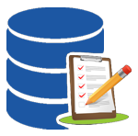
Database Assessment
Why Database Assessment
Our Approach
Installation using Default configuration
Old backup Strategy
Unused users in application database making it vulnerable.
Change in Security Policies
Evaluation of Stability of Databases
Details of Infrastructure
Past Problem History
Database Backup Strategy
Database
Current Security Policy
Operating System Checks
Capability
Database Analysis
All versions of databases for Oracle / MYSQL / MSSQL
Engineered Systems.
Traditional Infrastructure.
Document Security Issues
Recommendations
Final Signoff

Slide 10

Database Performance Tuning
Our Capability
Do I need Performance tuning?
Database Server Memory Tuning
Database Memory
Tuning
Storage Defragmentation
Operating System
Tuning
Database Query
Tuning
Cluster Replication Tuning
Backup Recovery Tuning
Is your Application Users are raising requests for timeouts?
Is your batch processes takes longer than usual.
Have you upgraded your Database?
Have you added more users and more functionalities on applications?
Have you consolidated Schemas of different applications?
Database
If answer to all these questions is YES .
You need Performance Tuning Services.

Slide 11
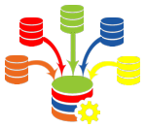
Database Consolidation – Business Drivers
Bound to have better service levels due to Standardized infrastructure
Higher up time
during patching
Faster aligning business need.
Faster provisioning
Faster / Automatic scale up and scale down
Higher Service Levels
Increased agility
Database as a service DaaS
Infrastructure as a service IaaS
Database
Cost Reduction
Reduced Complexity
Less servers
less Capital investment
Less Server Operations cost
Savings on Power
Environment friendly
Faster upgrades
Standardizing the Database operating systems.
Easy Manageability of Database infrastructure

Slide 12

Database Consolidation – Our Approach
What is objective of consolidation
Probability of successful consolidation
What is the present Infrastructure
What is present SLA ?
What is present support cost?
Present infrastructure Detail study
Specific requirements of certain application if any
Security setup for this infrastructure
Feasibility
Assessment
Database
Monitor the database growth
Optimize storage and CPU utilization on basis of real usage.
Monitor security Breech
Create Seed database for adding new database groups.
Database Grouping.
Security requirements.
Server requirements
Storage requirements.
Tool for DaaS for faster implementation and better support.
Architecture
Manage
Implementation
Implementing Storage and infrastructure
Implementing database provisioning applications
Group Database and create Seed Database for each.
Provision databases as per application needs
Migration of the Databases
Setup monitoring tools.
Test the load and fine tuning of the Database Infrastructure.
Performance monitor and changes as per requirements

Slide 13
Database Consolidation – Our Capability
Cloud Implementation
DBaaS
Schema Consolidation
Database Consolidation
Implementation and Support of database on Cloud products
Consolidation of multiple database server to one Engineered Database Infrastructure.
Faster Provisioning of database
Efficient and controlled Self service Database provisioning.
MS SQL server on Azure
Oracle Database Cloud solutions
Database on AWS Cloud
Schema consolidation Fitment Analysis
Performance and Database Parameter changes to suit consolidated schema
Schema Migrations and Consolidation Planning.
Consolidation using Oracle Database 12c
Consolidation of databases on Microsoft SQL Server
Database

Slide 14





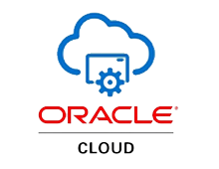






Database Infrastructure
Hardware
Capability
Cloud
Virtualization
Infrastructure Services and Consulting.
Design Database Infrastructure
Procurement Consulting.
Implementation at site
Database on Cloud server Implementation and Support
Virtualization Design and Implementation and support.
Operating System Installations of Windows / Linux .
Database

Slide 15
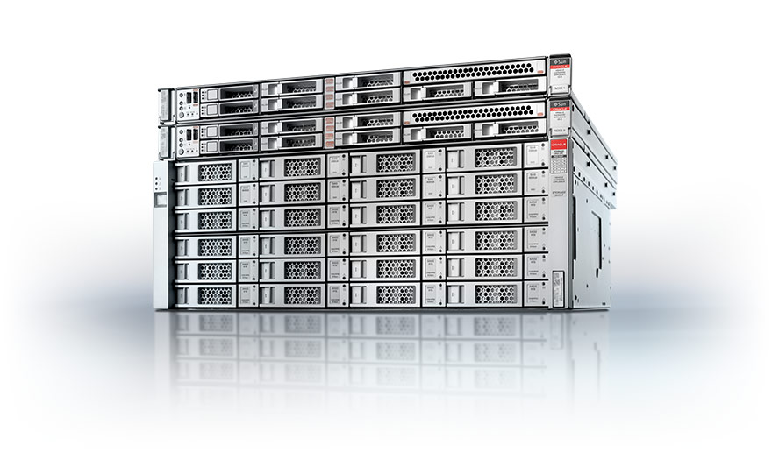
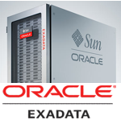
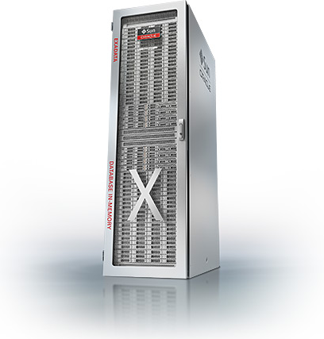
Oracle Engineered Systems
Consulting
Installation & Configuration
Migration Services
Tuning & Value Add Services
Engineered system Fitment
Migration Process and Documentation
Database as a service implementation
High Availability
Feasibility Study
Implementation Plans and Roadmaps.
Exadata Machine Configuration
Backup strategy Implementation
Non Oracle / oracle to Exadata Migration
Oracle EBS on Exadata
Zero downtime migration using Golden Gate
Database and application performance tuning after implementation
Database

Slide 16

Database Designing
Our Approach
Database Modelling Tools
ERWIN
PowerDesigner by SYBASE
MySQL Workbench
Microsoft SQL Management Studio
SQL Developer
Microsoft Visio
Discussion with Functional Teams
Support during development
Documentation and Final Delivery of model
Requirement Document Analysis
Discussion with Technical Team - Frameworks and Technology
Creating Logical / Functional Model
Creation of Physical model
Creation of Scripts
Database

Slide 18







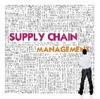
Customer Relationship Management
Service Management
Financial Management
Human Capital Management
Project Portfolio Management
Advance Procurement
Supply Chain Management
Consulting
Designing
Implementation
Development
Global Rollouts
Remote and Onsite Technical Support
Oracle Applications

Slide 19
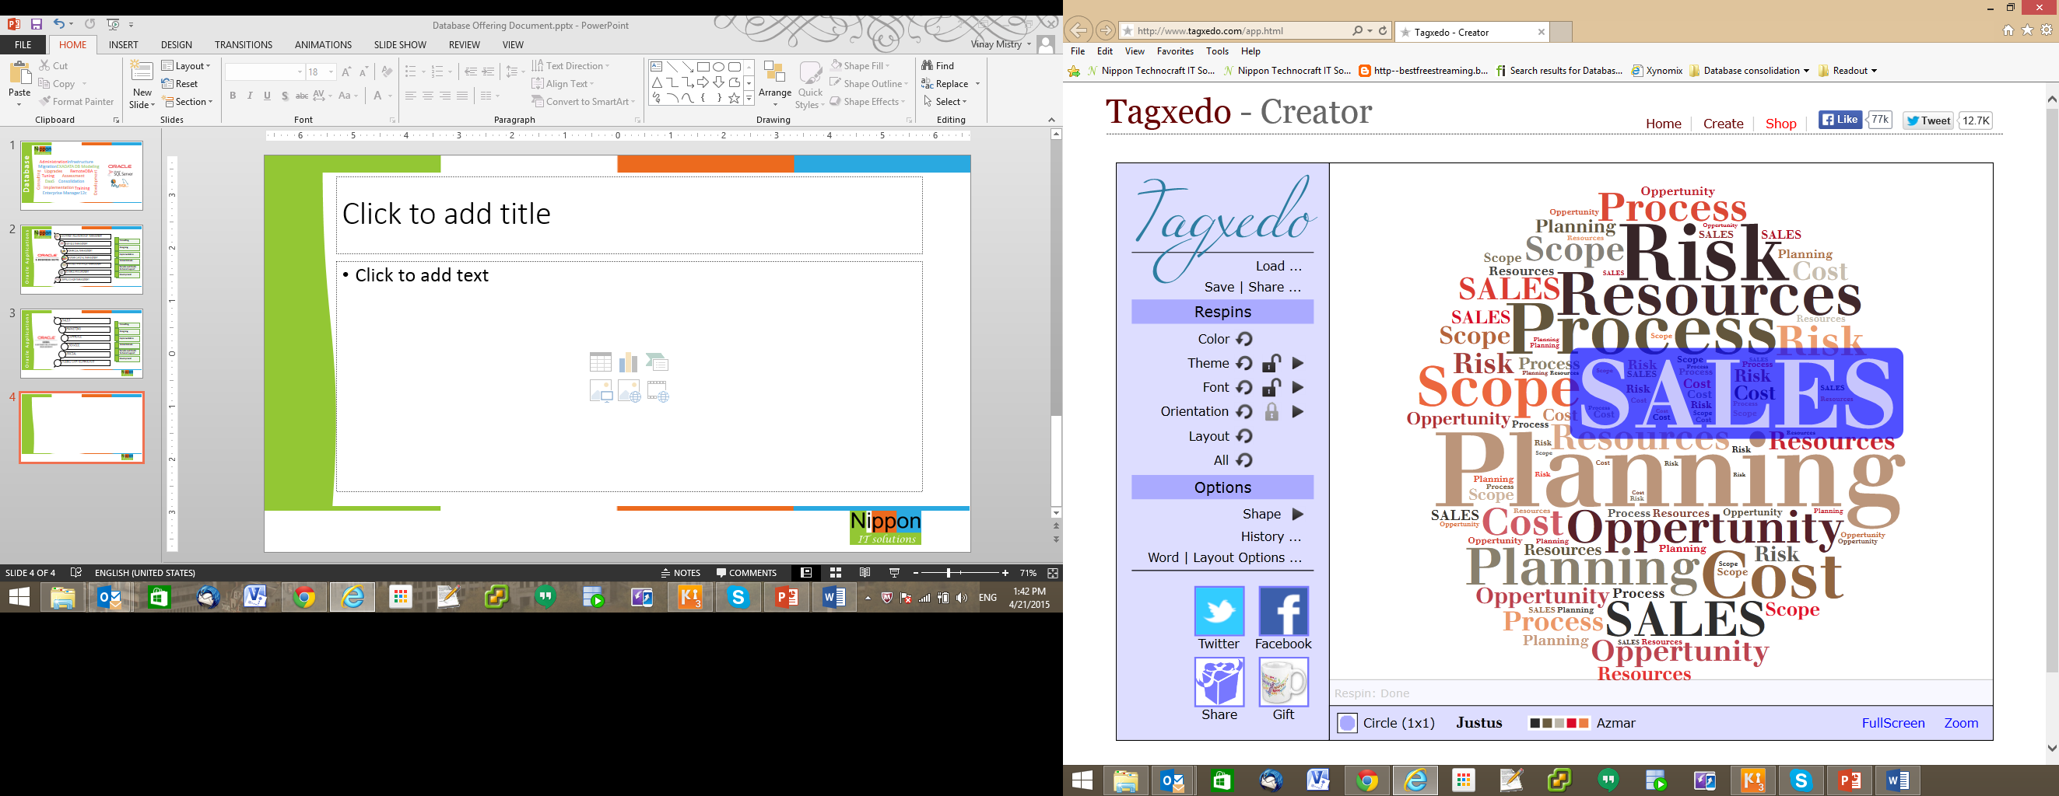
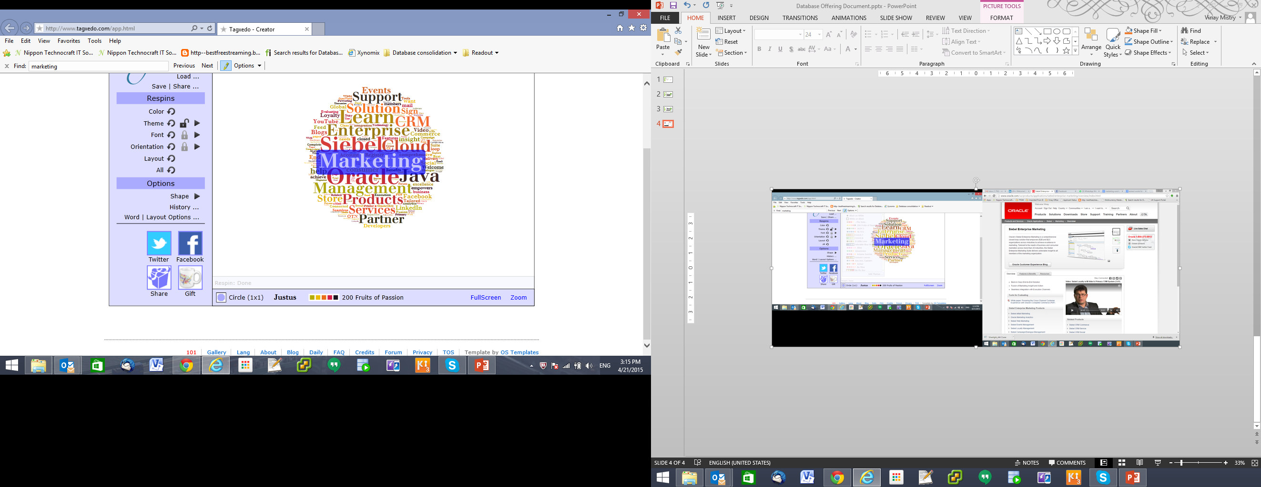
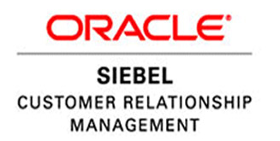
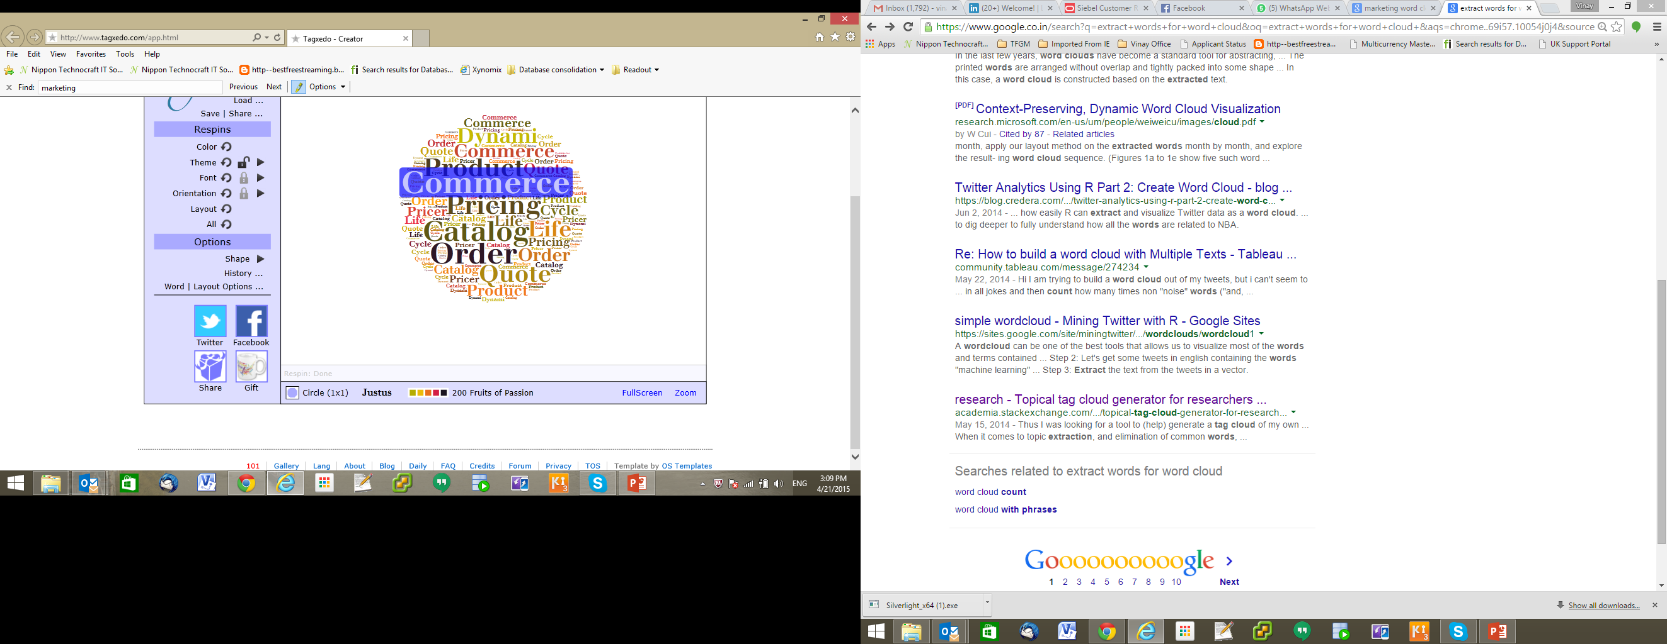
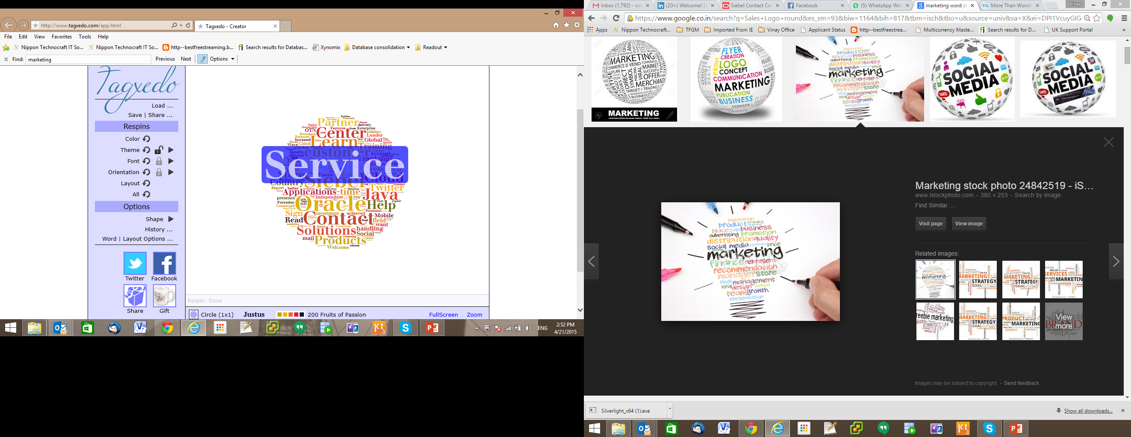
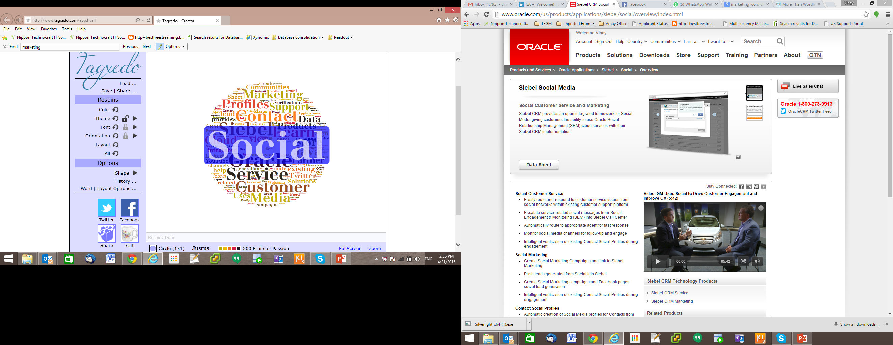
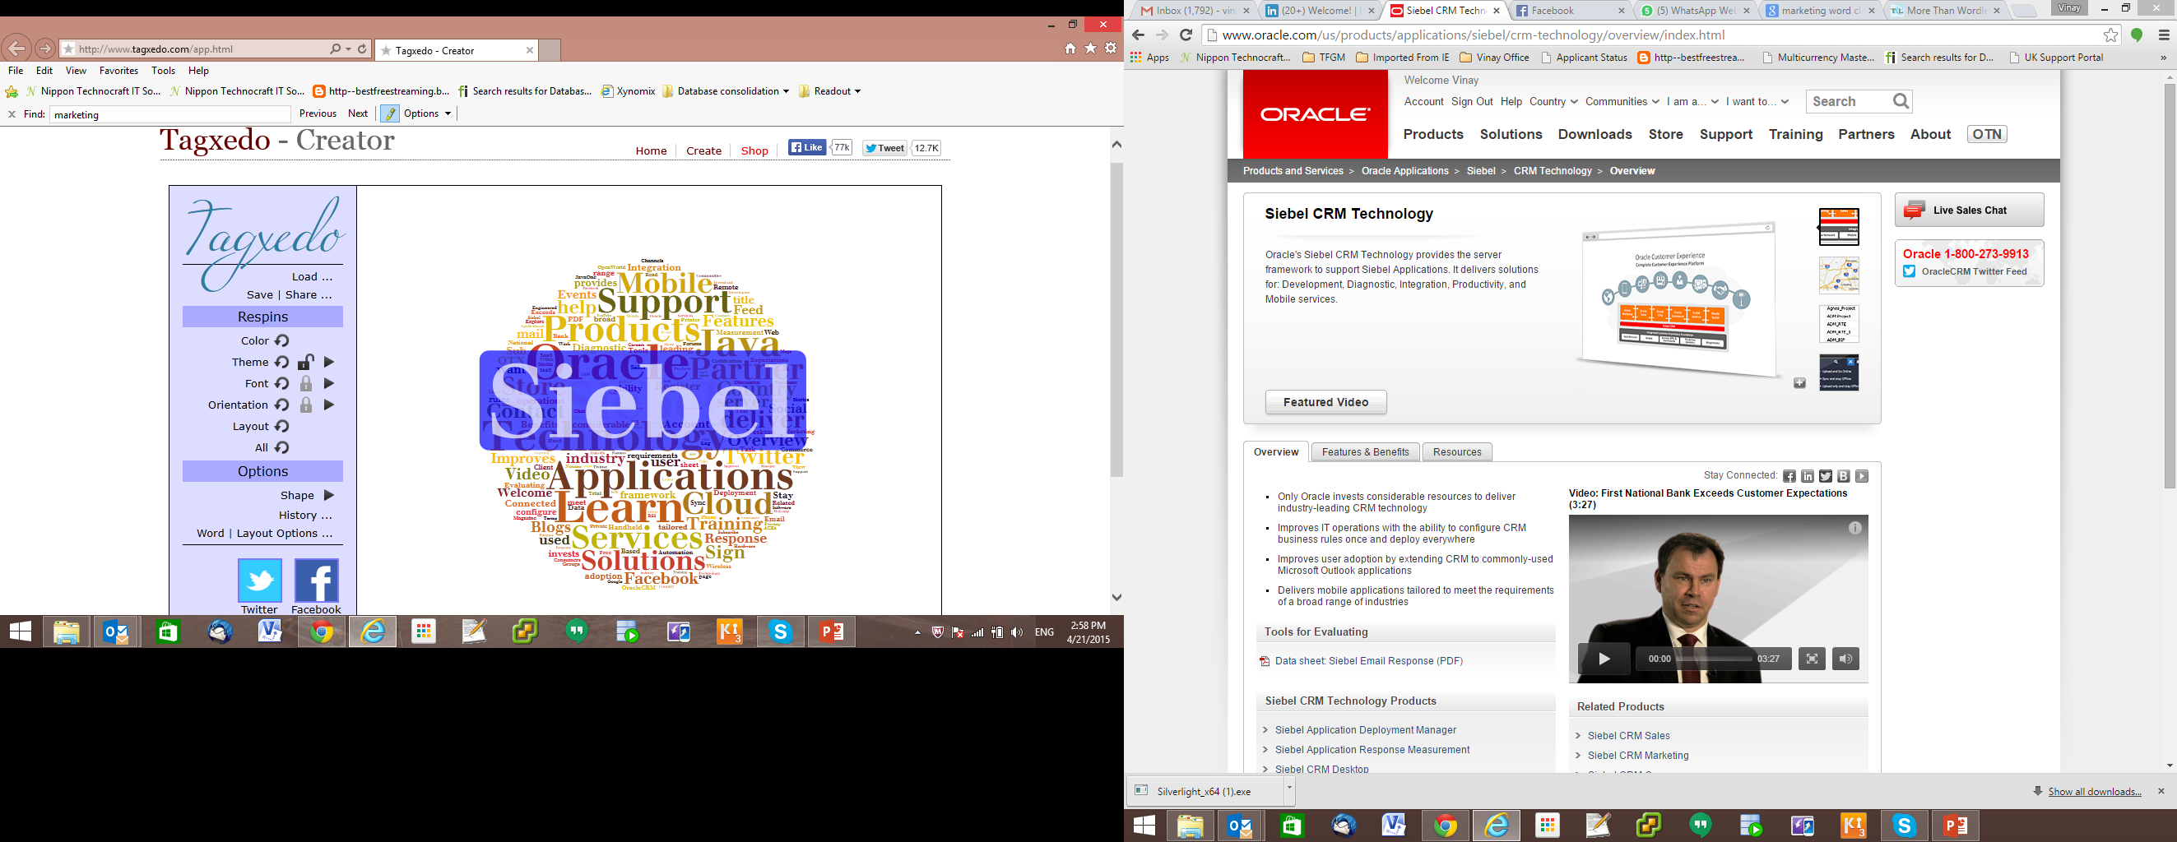
Sales
Marketing
Commerce
Service
Social
Siebel CRM Technology
Consulting
Remote and Onsite Technical Support
Designing
Implementation
Development
Global Rollouts
Oracle Applications

